Slide 1
From Acorn to Oak:
University of Auckland
Family Violence Project
Janet Fanslow, Assoc Prof., Co-Director, NZ Family Violence Clearinghouse
Trudie McNaughton, Pro-Vice Chancellor – Equity

Slide 2

New Zealand Family Violence Clearinghouse
Your national centre for research and information on family & whānau violence
Link family violence
research, policy and practice
Central site for information
Seek to support the
effectiveness of work to reduce
and eliminate violence
Practice
Research
NZFVC
Policy

Slide 3

Consistent with the “evidence to action theme” our reason for being is:
….that access to high-quality information is critical in ensuring family violence prevention strategies and initiatives are effective and achieve the greatest possible success.

Slide 4
Ways of making knowledge accessible
Website
Newsletter/Pānui
Data Summaries
Issues Papers
Selected Bibliographies
Seminars/Conferences
Lending library
Strategic literature searches
Timeline of Family Violence responses from 1867
Community Engagement
Information for:
  Policy makers
  Practitioners
  Researchers
  Students
  Media
  The general public

Slide 5
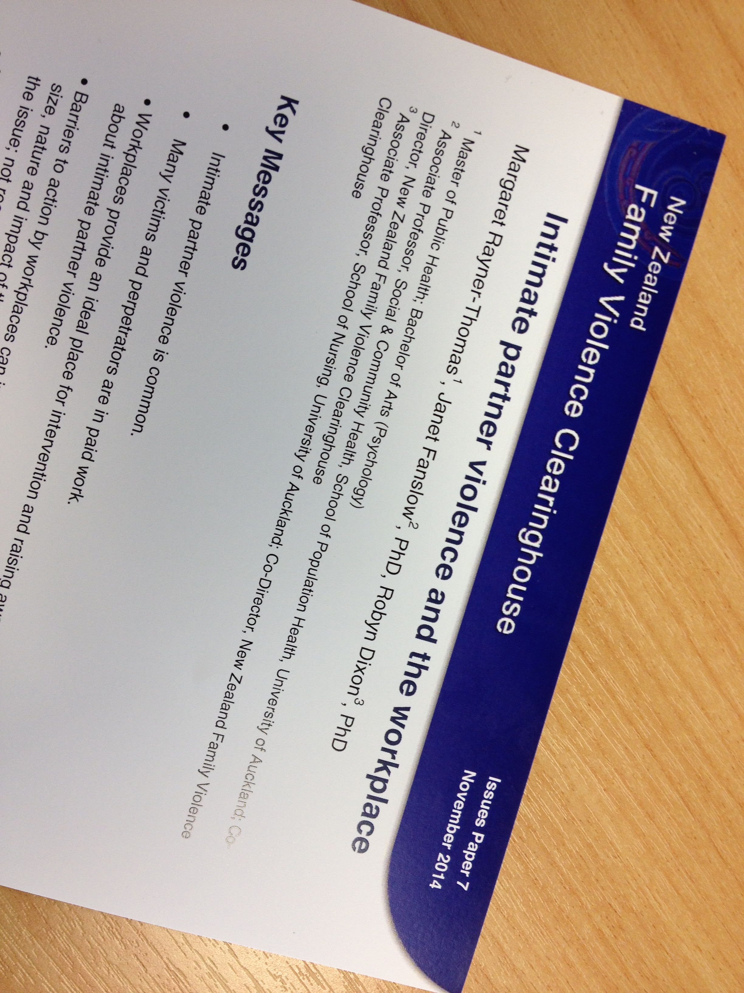
New Zealand Family Violence Clearinghouse
Publications
and events
Issues papers, data summaries, monthly newsletter, selected bibliographies
One-day conferences, seminars

Slide 6

Why a family violence project?
University critic and conscience responsibility
Health safety and wellbeing
To meet our equity goals

Slide 8
Evidence to Action: Key steps
Benchmarking
Stakeholder engagement
Policy, Guidelines, Implementation Plan, (training, communications)
Ongoing review
Notes:
ACKNOWLEDGEMENTS
MSD It’s not OK campaign . Auckland Council Community Action Youth and Drugs; Shine

Slide 9
Key factors in progress to date
Engaging leadership support
Credibility
  Personal
  Quality of evidence
Communication
Relationships
Resources

Slide 10
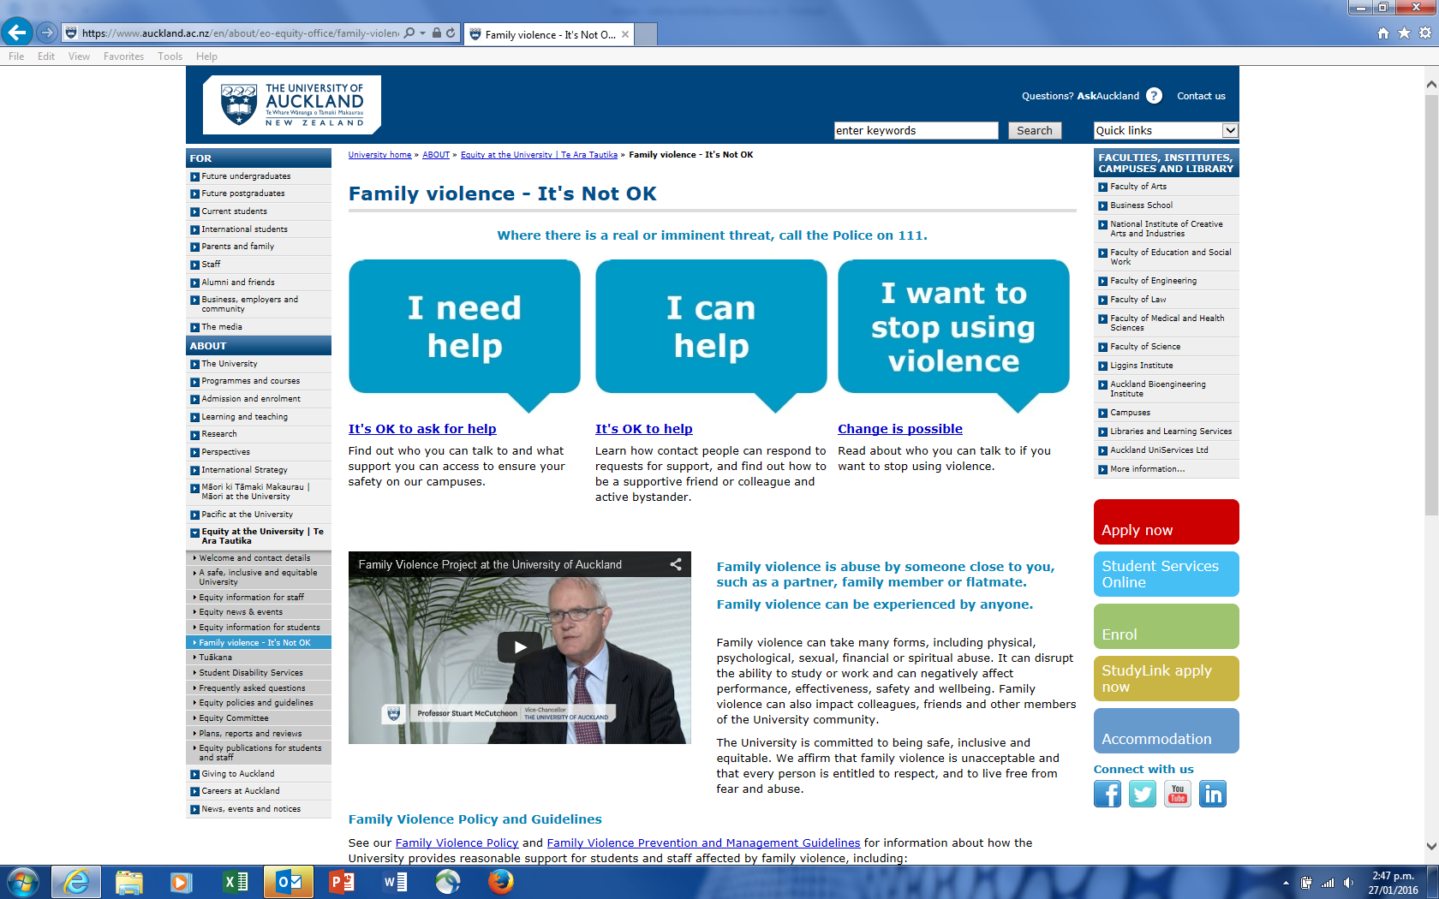
Notes:
based on successful programmes, research, and interventions including by other organisations

Slide 11

New Zealand Family Violence
Clearinghouse
www.nzfvc.org.nz
info@nzfvc.org.nz
The University of Auckland
Equity Office - Te Ara Tautika
www.equity.auckland.ac.nz
equity@auckland.ac.nz

